Slide 1

Capture Object Recognition Engine
Team // Loot Box
CORE

Slide 2

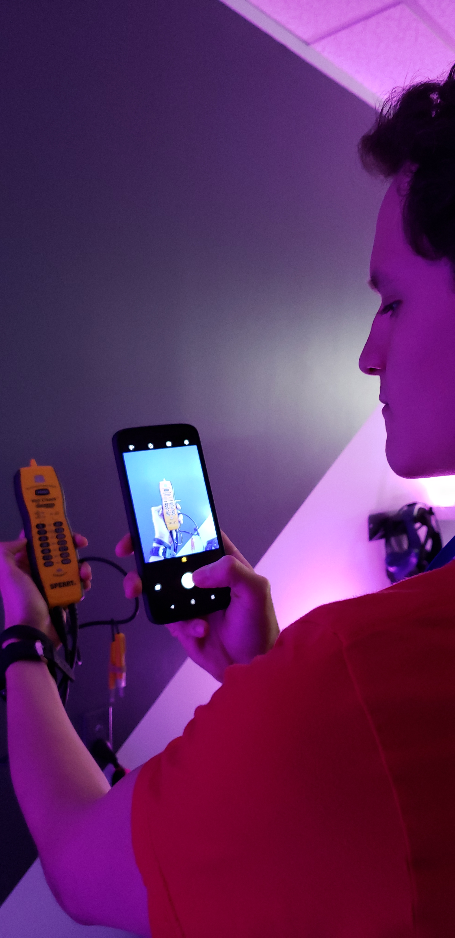
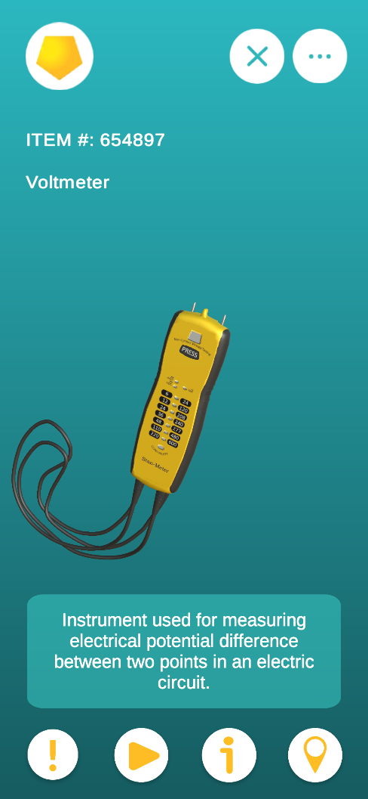

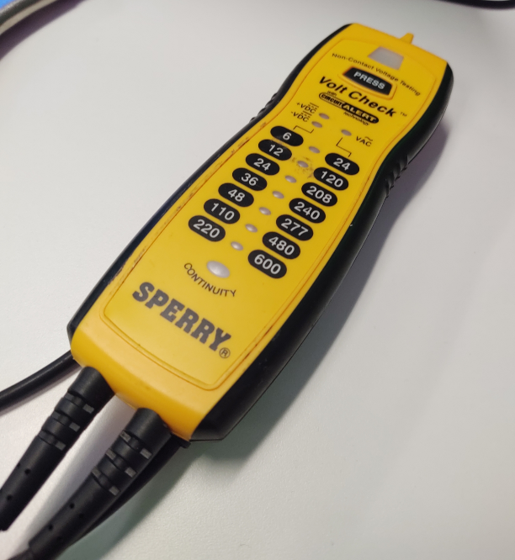
Computer Vision (Machine Learning)
Augmented Reality
?
=
?
Notes:
We are using the power of Augmented Reality and Computer Vision (Machine learning) to create an object classifier to recognize objects (inventory), to provide the user with item details. This will make it so when someone has a question to what an item is or where does it belong; all they have to do is take out their phone open the app and snap a photo of the object in question; and information rewarding the item will be presented.
Our approach uses the power of Unity to create virtual scenarios with 3D models allowing us to create thousands of images that are fed to train the AI. All we need now is a library of 3D models or at request, and within Unity we can start training our app further.

Slide 3
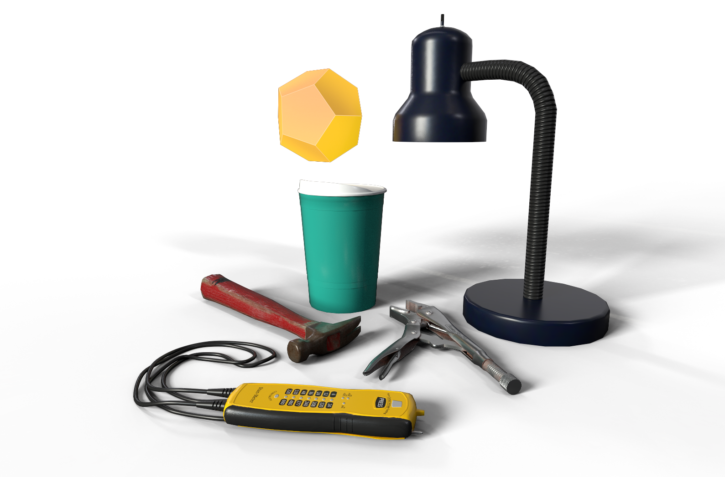
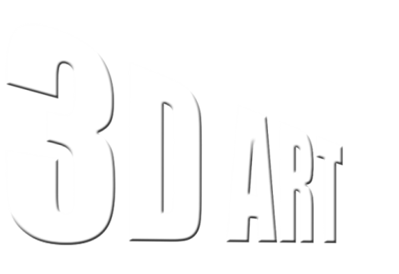
3D Art
How was it made?
Reasons
Quality

Slide 4

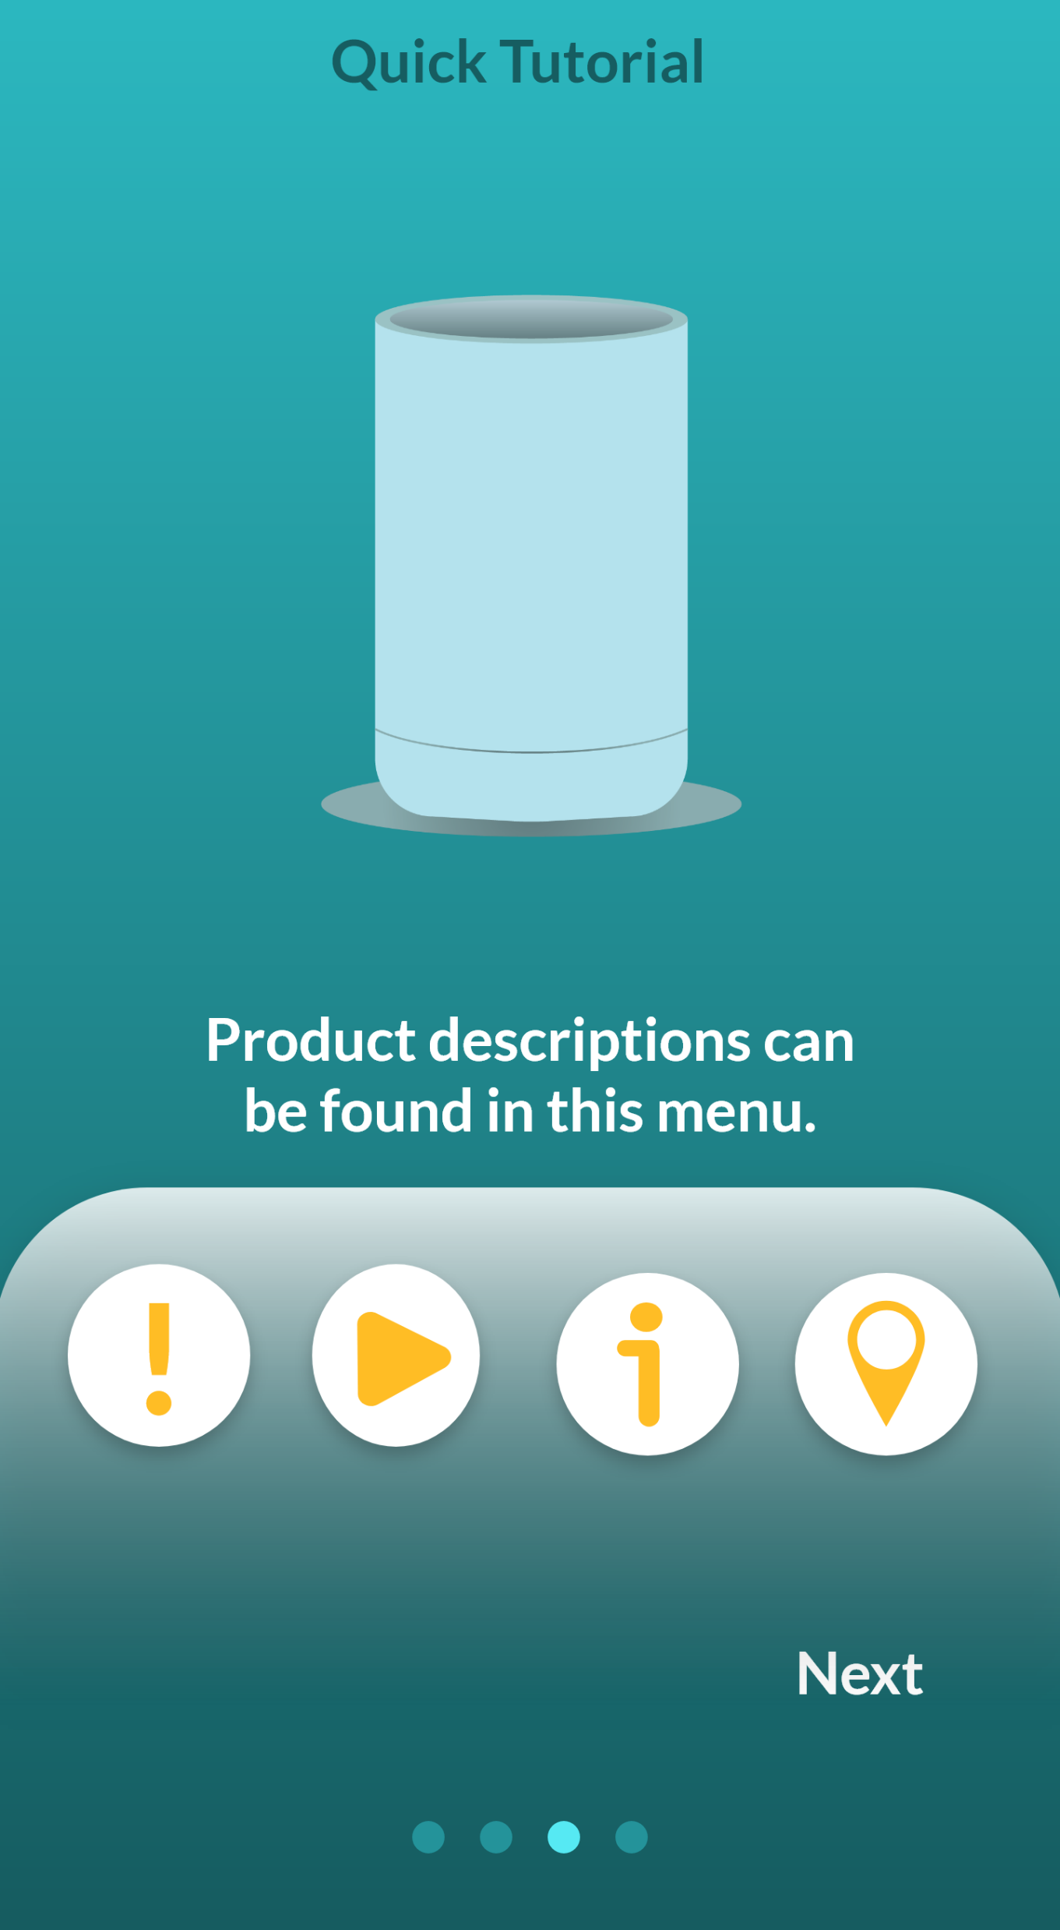
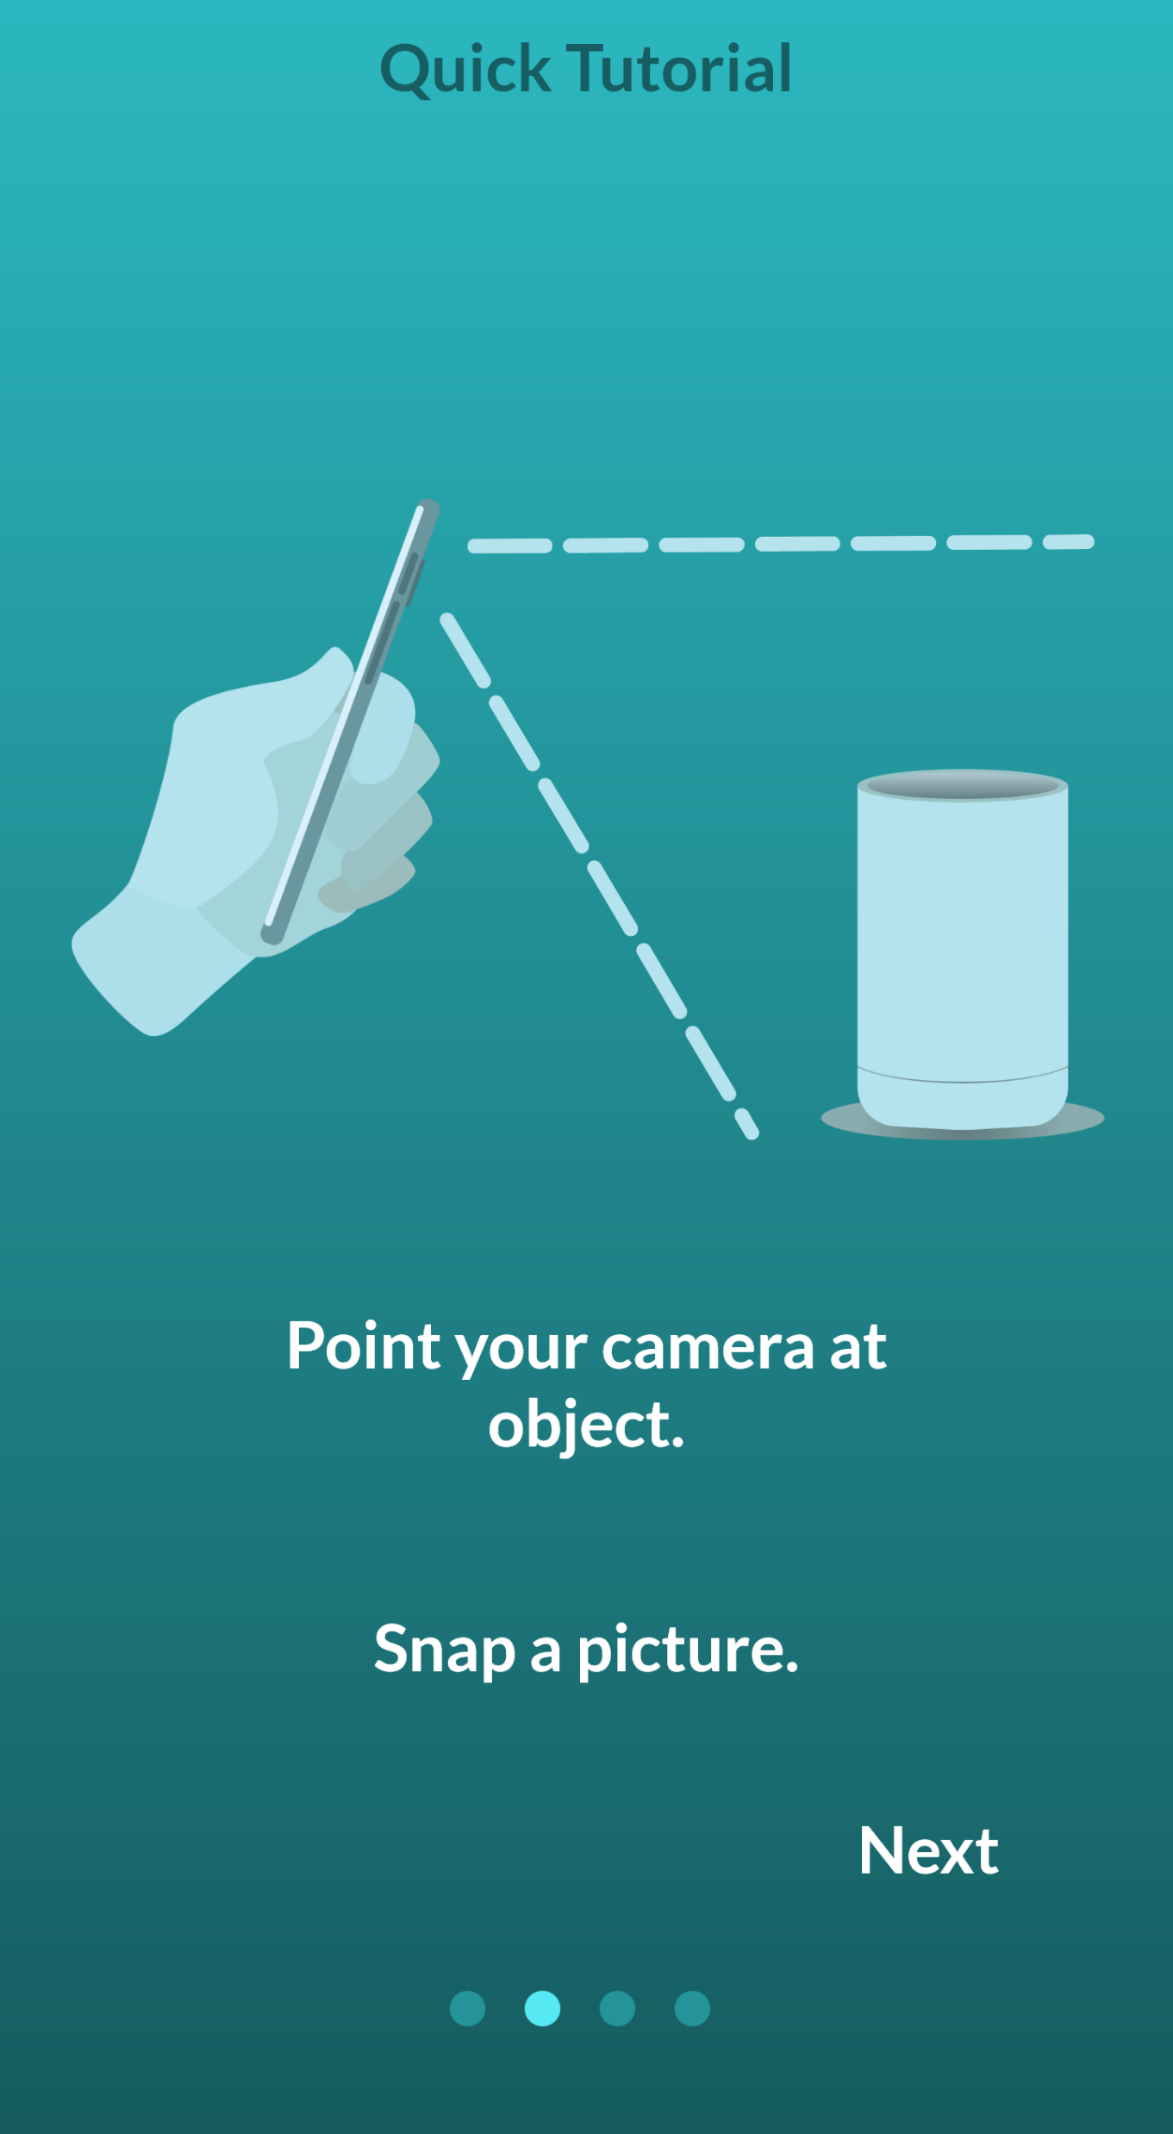

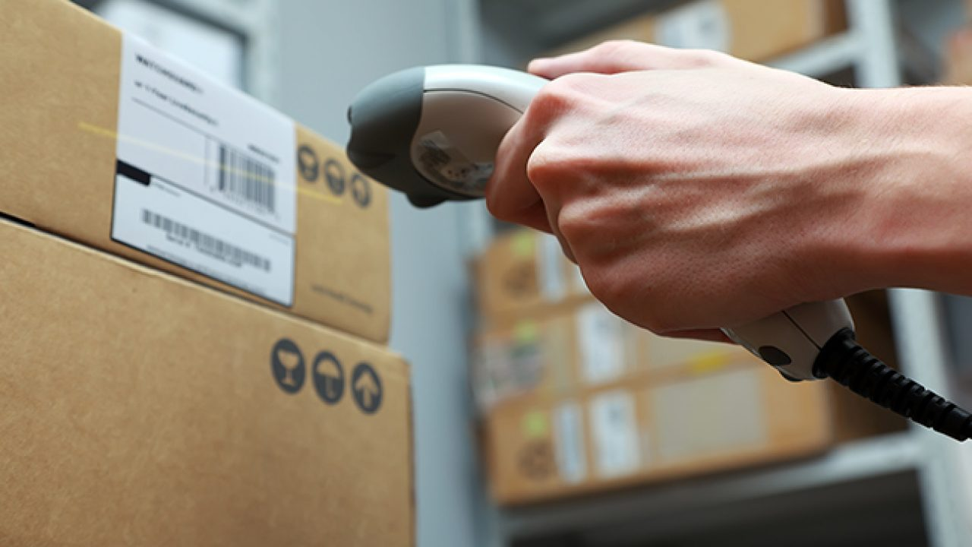


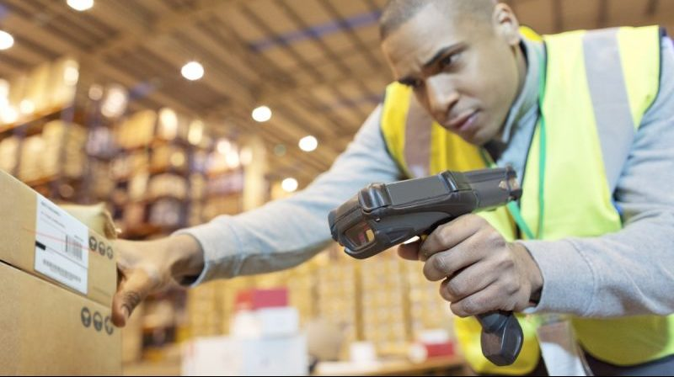
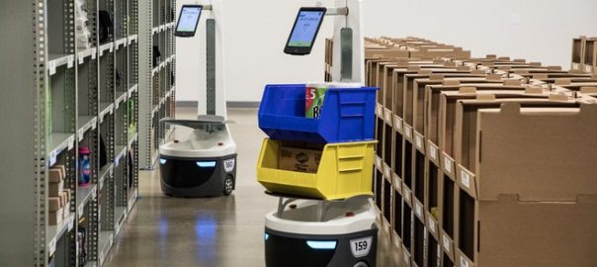
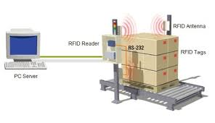
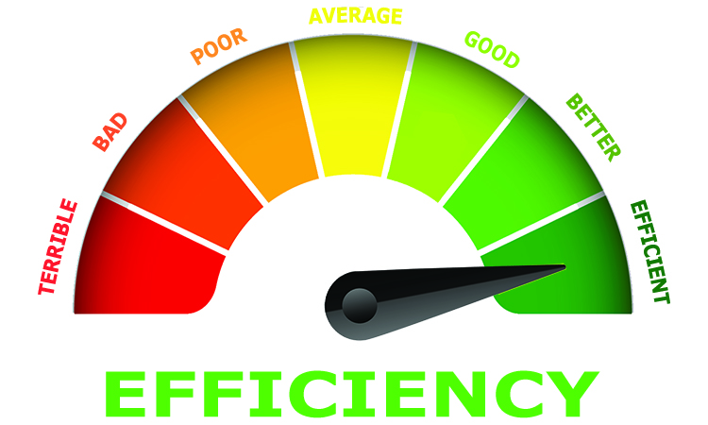
Warehouse Needs
UI/UX
Pain Points
Torn/Missing Labels
Possible Forgotten
Inventory
Miscounted
Inventory
Future Possibility
RFID Tech
Barcodes
Robots
+
+
+
=
CORE
Notes:
Inventory Management is the fundamental building block to longevity.
Currently some paint points are torn/missing labels, possible forgotten inventory, and/or miscounted inventory.
When looking into WMS’s, I selected 10 and compared them. I found that out of those 10, 5 had no mobile device support. 3 had support for either IOS or Android and 2 had support for both platforms. A study done by software path in 2019, gathered data from about 164 WMS projects and they found that depending on the company size – on average those companies took more or less than 21 weeks to choose a WMS software. About 91.5% of those companies were considering a cloud based solution, the average budget per user over a 5 year period was 10,000$. Why do these companies choose to spend so much time and resources on selecting a WMS? The top reasons were to increase efficiency, and obtain greater functionality.
If that’s the case, why not invest in Core and bridge that gap between this software and all of the warehouse employees? With further research, study and development, this app could train employees, guide users to exact locations, request replacement parts from other warehouses, minimize duplicates in inventory – and considering all that WMS already offer – it could even be a dashboard to those folks who need to forecast for their products or suggest where products should be placed for faster deliveries.

Slide 5
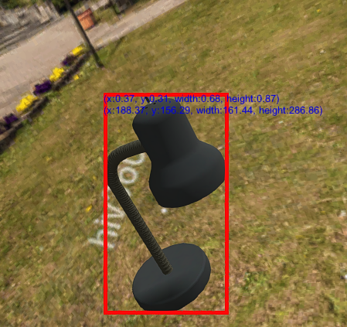
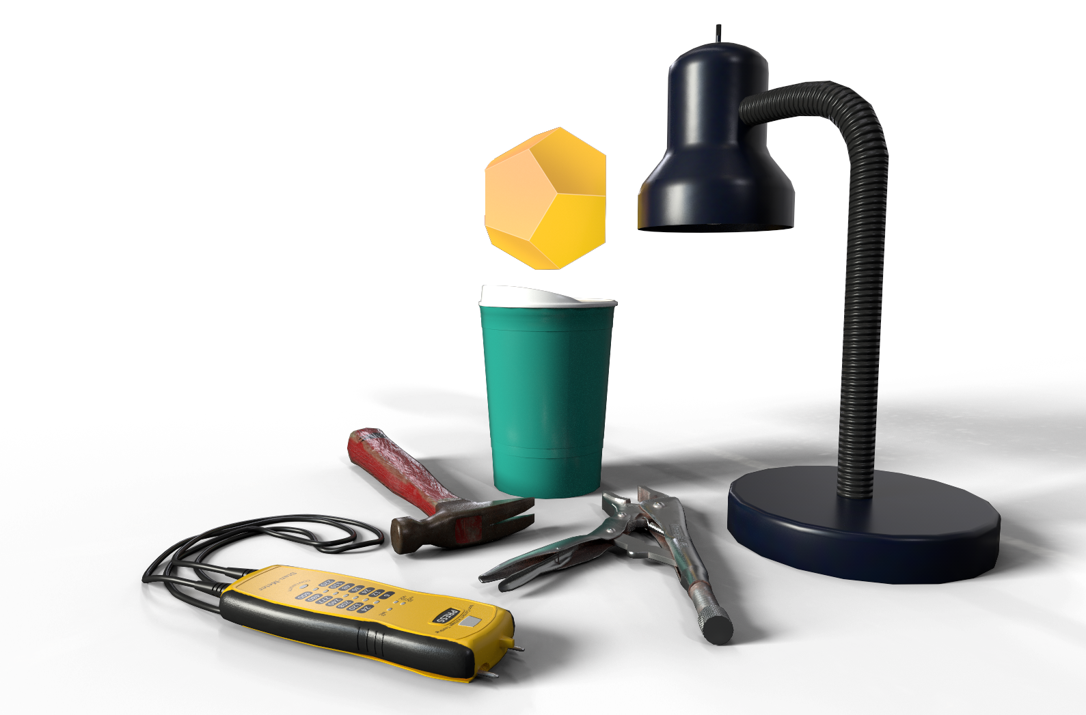
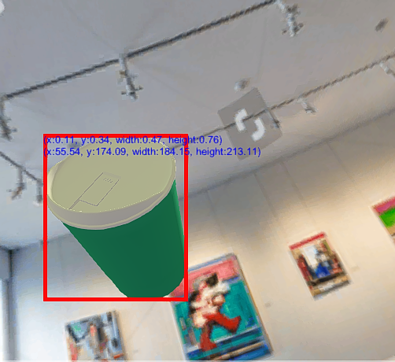


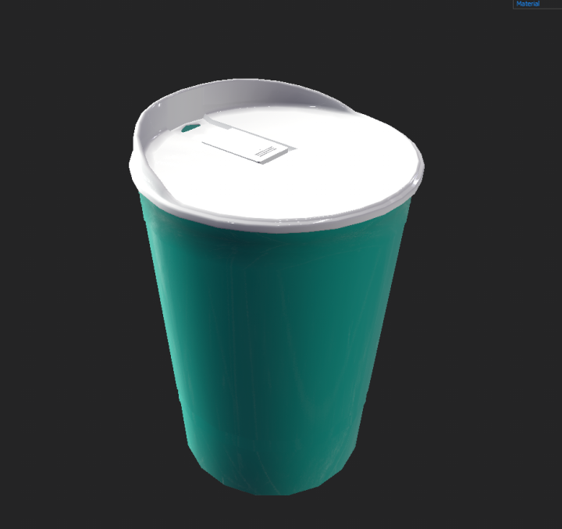
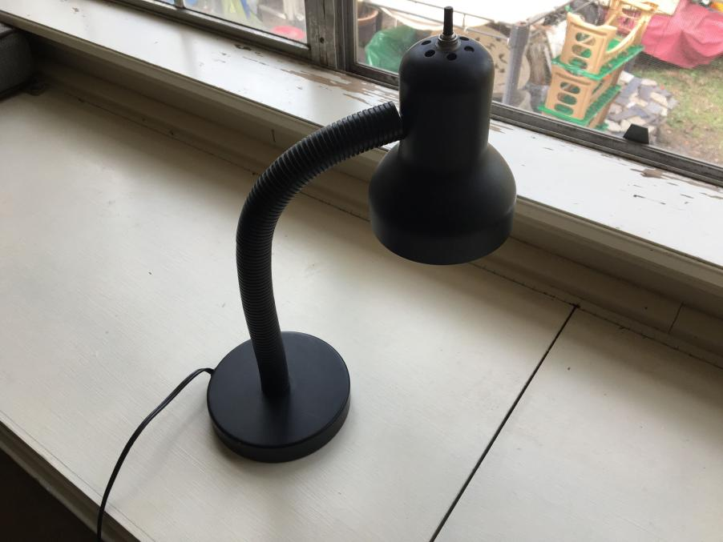

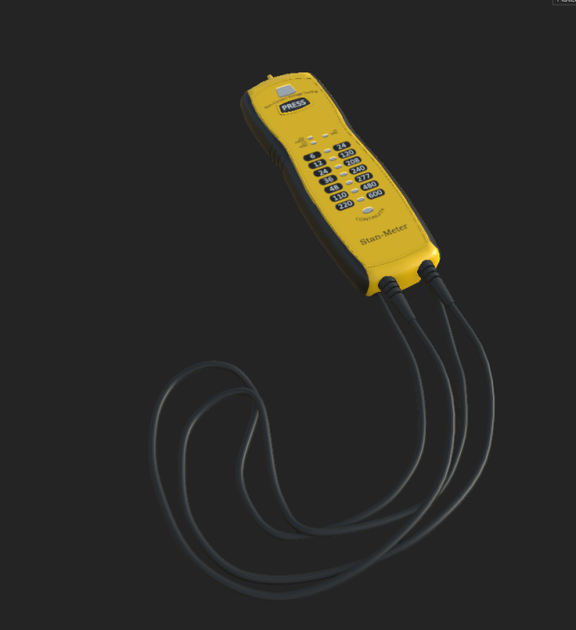
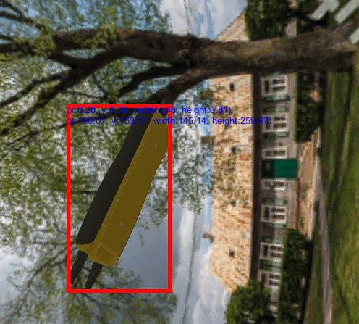

Machine Learning Pipeline
Stage 1
User import 3D model of real-world product
Stage 2
Computer creates fake images & labels from 3D model.
Stage 3
Computer processes images to Microsoft ML service
Stage 4
Microsoft creates Ai model for 3rd party use.
Programmers
Microsoft’s Custom Vision
Images
Dataset
Microsoft’s Custom Vision

Slide 6


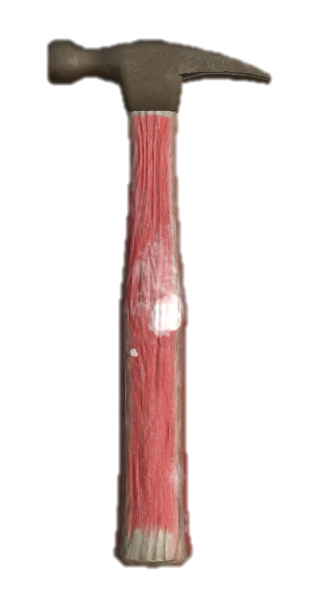


Powered by Machine Learning and Computer Vision
Result!
Programmers
Prediction
Custom Vision
Training Data
Request
CORE

Slide 7
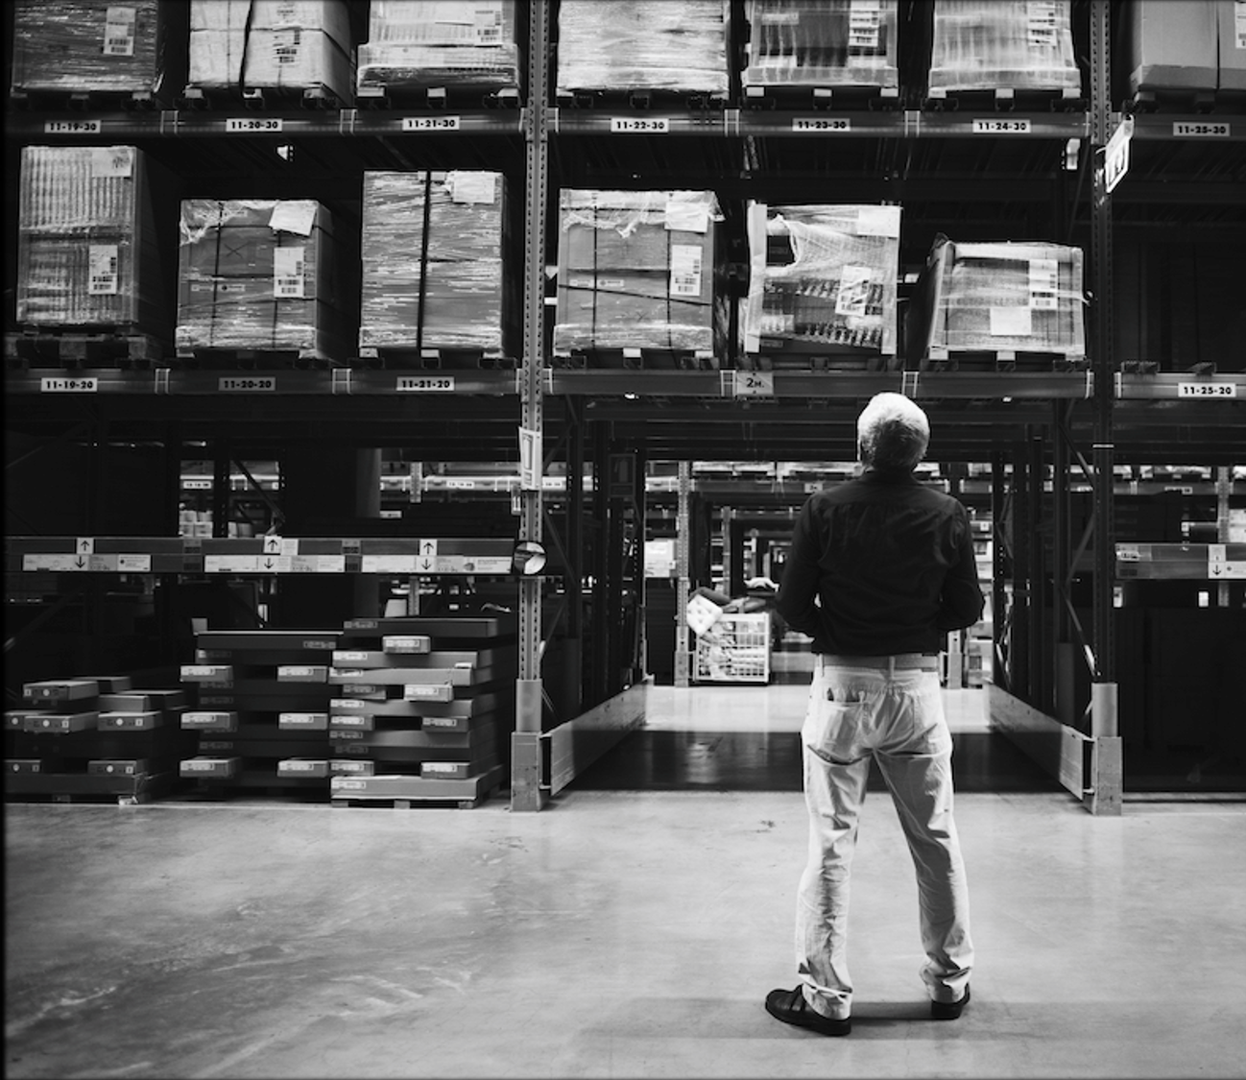
Inventory Loss​
Last Thoughts
Parts and equipment are hard to keep track of. Keeping track of inventory and location with RFID chips and markers​ are made inefficient due to the high amount of volume.
Notes:
OnInventory Management is the fundamental building block to longevity.
Warehouse management software is estimated a 14.1% compound annual growth from 2017 – 2024. A study done in 2019 by Software Path gathered and analyzed data from 164 WMS projects active in that year. The average budget per user for WMS software is 10k dollars (which is about 167$ per user per month). Additionally, on average, companies spend a little more or less than 21 weeks selecting WMS. About 31.58% of those employees used WMS.

Slide 8
Thank you!
Team // Loot Box
Questions?

